Slide 1
Messaging Passing and Belief Propagation lecture-3 Course on Graph Neural Networks for Knowledge Graph Systems (Winter Term 22/23)
Prof. Dr. Holger Giese (holger.giese@hpi.uni-potsdam.de)
Christian Medeiros Adriano (christian.adriano@hpi.de) - “Chris”
Matthias Barkowsky (matthias.barkowsky@hpi.de)
Iqra Zafar (iqra.zafar@hpi.de)

Slide 2
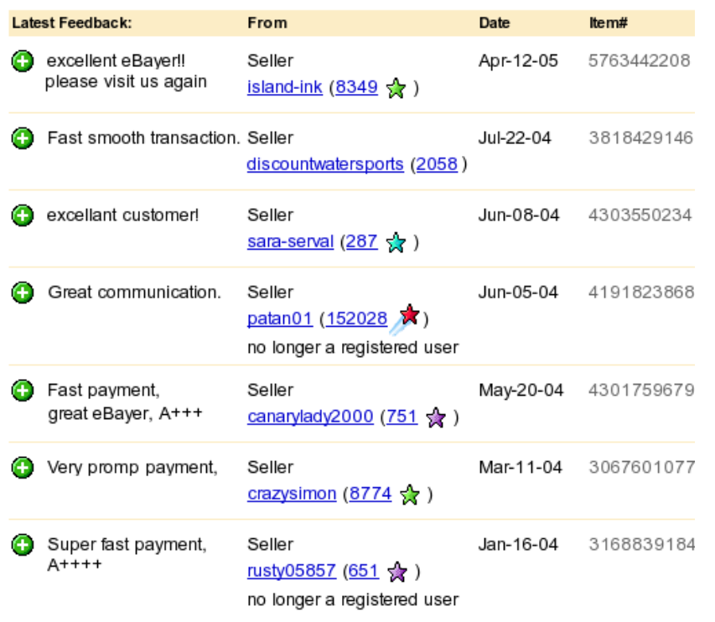
Fraud detection
eBay page listing the recent feedbacks for one user
Auction fraud
Among all the monetary losses reported, auction fraud accounted for 41%,with an average loss of $385.
Internet fraud complaint center: Ic3 2004 internet fraud-crime report.
2019 - Business Email Compromise $26 Billion Scam
https://www.ic3.gov/Media/Y2019/PSA190910
Other scenarios
Document classification
Fake news
Part speech tagging
Link prediction
Optical character recognition
Image/3D data segmentation
Entity resolution in sensor networks
source: Pandit, Shashank, et al. "Netprobe: a fast and scalable system for fraud detection in online auction networks." Proceedings of the 16th international conference on World Wide Web. 2007.

Slide 3
Goal: how to label my neighbors?
E
E
A
A
F
F
B
H
B
H
C
G
C
G
D
D

Slide 4
Lecture topics
Relational Classifier
Iterative Classifier
Belief Propagation
Main sources of these slides
- Lecture-6 of CS224W: Machine Learning with Graphs (Stanford / Fall 2019): http://web.stanford.edu/class/cs224w/
- Slides of talk at ICDM 2016. “Edge Weight Prediction in Weighted Signed Networks”:
https://cs.stanford.edu/~srijan/wsn/

Slide 5
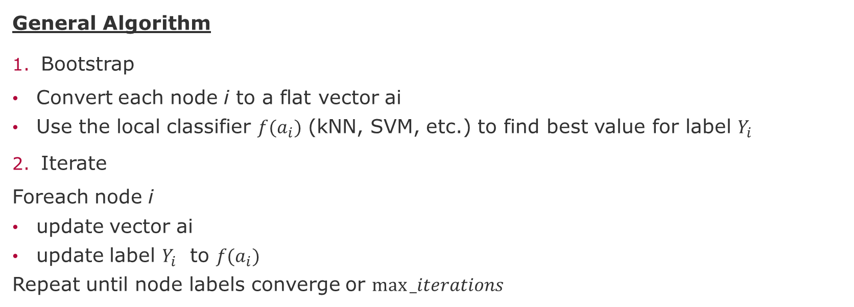
Iterative Classifiers
General Algorithm
Bootstrap
Convert each node i to a flat vector ai
Use the local classifier $f(a_{i})$ (kNN, SVM, etc.) to find best value for label $Y_{i}$
Iterate
Foreach node i
update vector ai
update label $Y_{i}$ to $f(a_{i})$
Repeat until node labels converge or $max⁡_iterations$
Caveats
Convergence not guaranteed
Model ignores graph node features

Slide 6
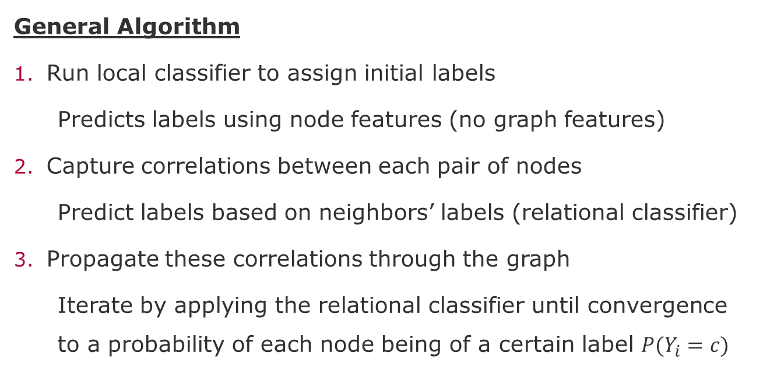
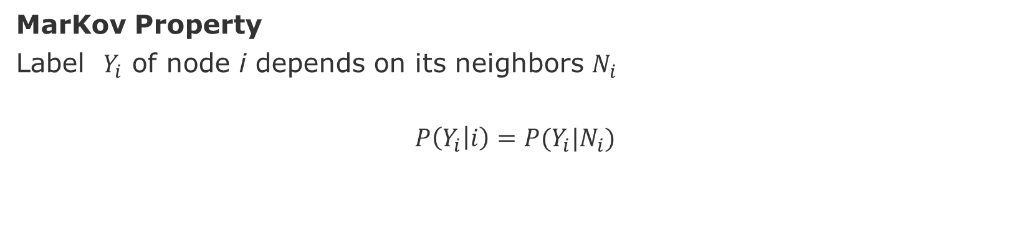
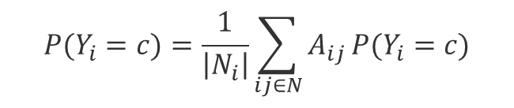
Relational and Collective Classification
MarKov Property
Label $Y_{i}$ of node i depends on its neighbors $N_{i}$
$$P\left(Y_{i} | i\right)=P(Y_{i}|N_{i})$$
General Algorithm
Run local classifier to assign initial labels
Predicts labels using node features (no graph features)
Capture correlations between each pair of nodes
Predict labels based on neighbors’ labels (relational classifier)
Propagate these correlations through the graph
Iterate by applying the relational classifier until convergence to a probability of each node being of a certain label $P(Y_{i}=c)$
Caveats
Convergence not guaranteed
Model ignores graph features
$$P(Y_{i}=c)=\frac{1}{\left|N_{i}\right|}\sum_{ij∈N}{A_{ij}}P(Y_{i}=c)$$

Slide 7
Goal: how to label my neighbors?
75%
75%
E
E
E
100%
100%
A
A
A
75%
F
F
50%
F
B
H
B
H
B
H
100%
C
G
C
G
C
D
D
G
85%
D
100%
75%
85%
75%

Slide 8
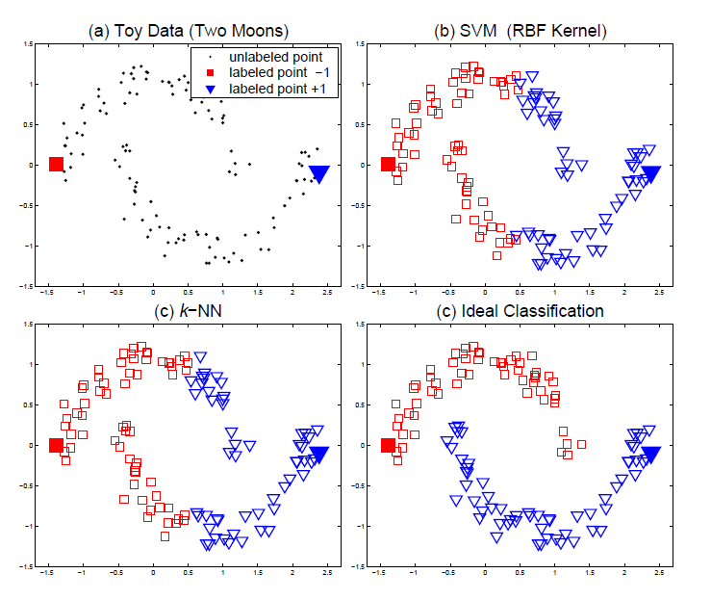
Limitations of local features
Assumptions:
Neighboring nodes are more likely to share the same label
Nodes on the same structure (cluster) are more likely to share the same label
1
1
?
source: Zhou, D., Bousquet, O., Lal, T. N., Weston, J., & Schölkopf, B. (2004). Learning with local and global consistency. Advances in neural information processing systems - NIPS, 16(16), 321-328.
Notes:
https://networkx.org/documentation/stable//reference/algorithms/node_classification.html

Slide 9
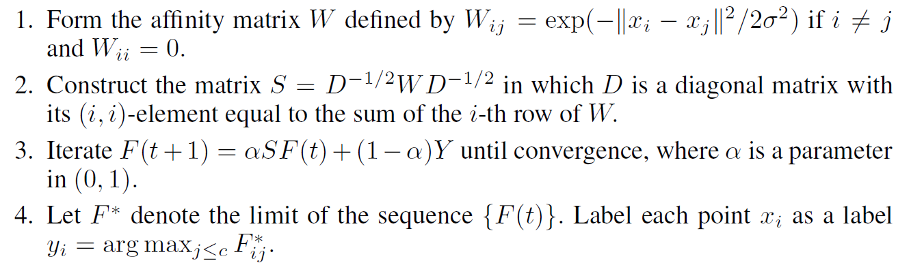
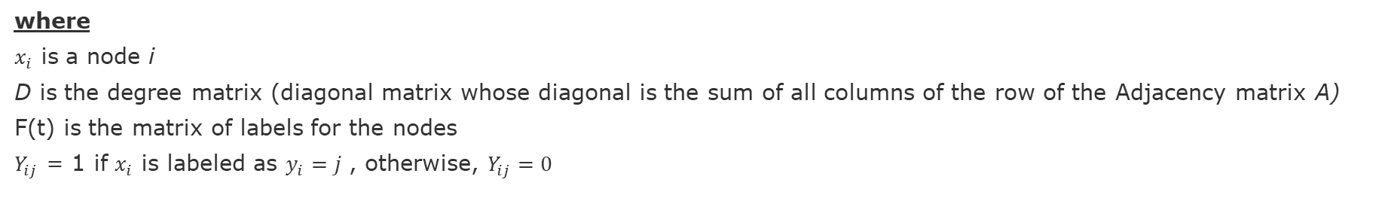
Combining local and global features [Zhou et al. 2004]
Goal: Label nodes $x_{i}$ using a set of labels L
Algorithm
where
$x_{i}$ is a node i
D is the degree matrix (diagonal matrix whose diagonal is the sum of all columns of the row of the Adjacency matrix A)
F(t) is the matrix of labels for the nodes
$Y_{ij}$ = 1 if $x_{i}$ is labeled as $y_{i}=j$ , otherwise, $Y_{ij}=0$
source: Zhou, D., Bousquet, O., Lal, T. N., Weston, J., & Schölkopf, B. (2004). Learning with local and global consistency. Advances in neural information processing systems - NIPS, 16(16), 321-328.

Slide 10


Rating reliability [Kumar et al. 2016]
-0.2
+0.1
-0.9
+1
Positive edges: Trust, Like, Support, Agree
Negative edges: Distrust, Dislike, Oppose, Disagree
Weights: Strength of the relation
Fairness [0,1]: how reliable a user is in rating others, i.e., gives “correct” ratings to other users.
Goodness [-1,1]: how fair user rate it, i.e., user gets high ratings from fair users.
sources:
https://cs.stanford.edu/~srijan/wsn/
Kumar, Srijan, et al. "Edge weight prediction in weighted signed networks." ICDM, IEEE, 2016.

Slide 11
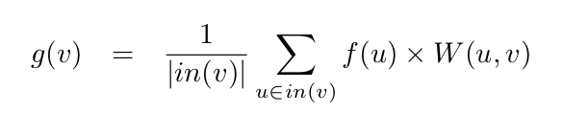
Goodness
W(u,v)
Fairness
f(u)
Goodness
g(v)
Weighted incoming rating
sources:
https://cs.stanford.edu/~srijan/wsn/
Kumar, Srijan, et al. "Edge weight prediction in weighted signed networks." ICDM, IEEE, 2016.

Slide 12

Fairness
W(u,v)
Fairness
f(u)
Goodness
g(v)
Average deviation of user u’s ratings
Deviation of rating from goodness
sources:
https://cs.stanford.edu/~srijan/wsn/
Kumar, Srijan, et al. "Edge weight prediction in weighted signed networks." ICDM, IEEE, 2016.

Slide 13
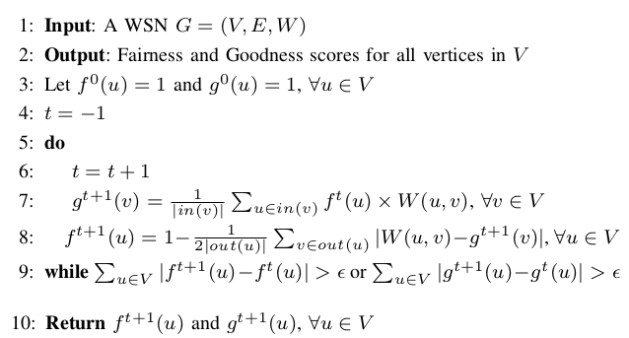
Fairness and Goodness Algorithm
Initialization
Update
Goodness
Update
Fairness
sources:
https://cs.stanford.edu/~srijan/wsn/
Kumar, Srijan, et al. "Edge weight prediction in weighted signed networks." ICDM, IEEE, 2016.

Slide 14
Initialization: All Fair and All Good
f(u) = 1
f(u) = 1
g(v) = 1
f(u) = 1
g(v) = 1
f(u) = 1
g(v) = 1
f(u) = 1
f(u) = 1
sources:
https://cs.stanford.edu/~srijan/wsn/
Kumar, Srijan, et al. "Edge weight prediction in weighted signed networks." ICDM, IEEE, 2016.

Slide 15

Updating Goodness - Iteration 1
f(u) = 1
f(u) = 1
g(v) = 0.67
f(u) = 1
g(v) = 0.67
f(u) = 1
g(v) = -0.67
f(u) = 1
f(u) = 1
sources:
https://cs.stanford.edu/~srijan/wsn/
Kumar, Srijan, et al. "Edge weight prediction in weighted signed networks." ICDM, IEEE, 2016.

Slide 16

Updating Fairness - Iteration 1
f(u) = 0.58
f(u) = 0.92
g(v) = 0.67
f(u) = 0.92
g(v) = 0.67
f(u) = 0.92
g(v) = -0.67
f(u) = 0.92
f(u) = 0.92
sources:
https://cs.stanford.edu/~srijan/wsn/
Kumar, Srijan, et al. "Edge weight prediction in weighted signed networks." ICDM, IEEE, 2016.

Slide 17
Message Passing and Belief propagation

Slide 18
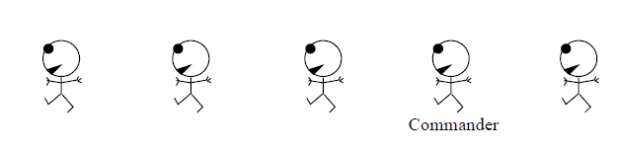
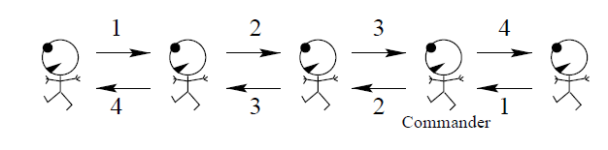
Message passing [Mckay 2003]
Counting soldiers in a snowstorm
Algorithm
1. If you are the front soldier in the line, say the number “one” to the soldier behind you.
2. If you are the rearmost soldier in the line, say the number “one” to the soldier in front of you.
3. If a soldier ahead of or behind you says a number to you, add “one” to it, and say the new number to the soldier on the other side.
3 (ahead me)+1 (behind me)+1(myself) = 5
[MacKay 2003] MacKay, D. JC.(2003), Information theory, inference and learning algorithms. Cambridge university press.

Slide 19
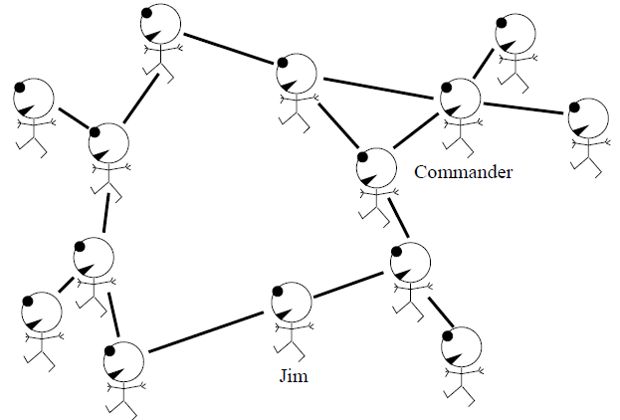
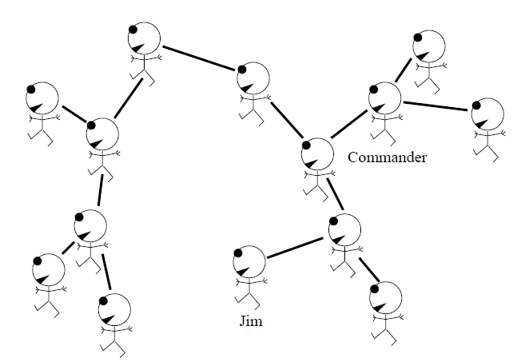
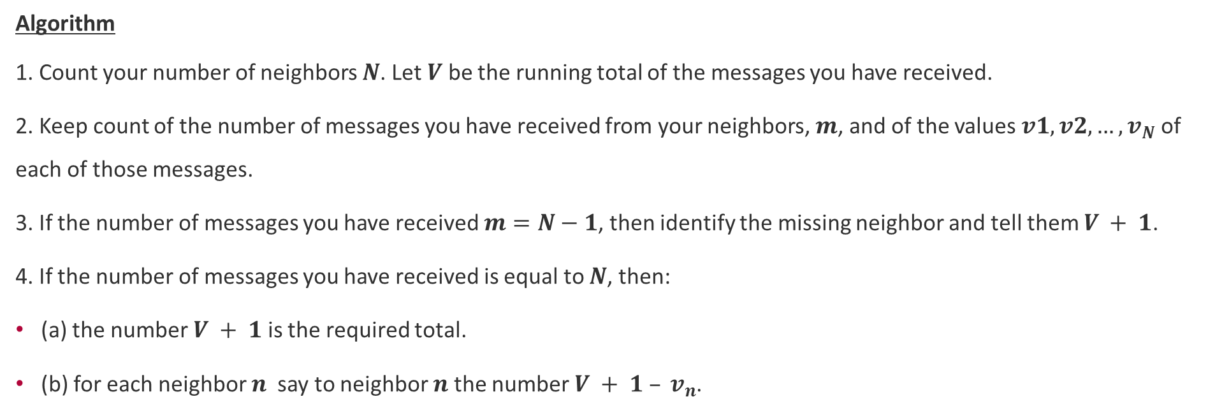
Message passing for Counting in a Graph [McKay 2003]
Algorithm
1. Count your number of neighbors $N$. Let $V$ be the running total of the messages you have received.
2. Keep count of the number of messages you have received from your neighbors, $m$, and of the values $v1, v2, …,v_{N}$of each of those messages.
3. If the number of messages you have received $m=N−1$, then identify the missing neighbor and tell them $V + 1$.
4. If the number of messages you have received is equal to $N$, then:
(a) the number $V + 1$ is the required total.
(b) for each neighbor $n$ say to neighbor $n$ the number $V + 1 – v_{n}$.
[MacKay 2003] MacKay, D. JC.(2003), Information theory, inference and learning algorithms. Cambridge university press.

Slide 20
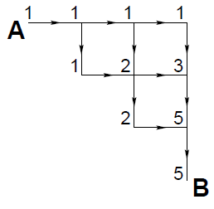
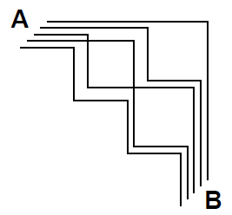
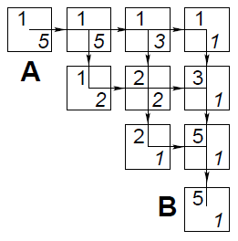
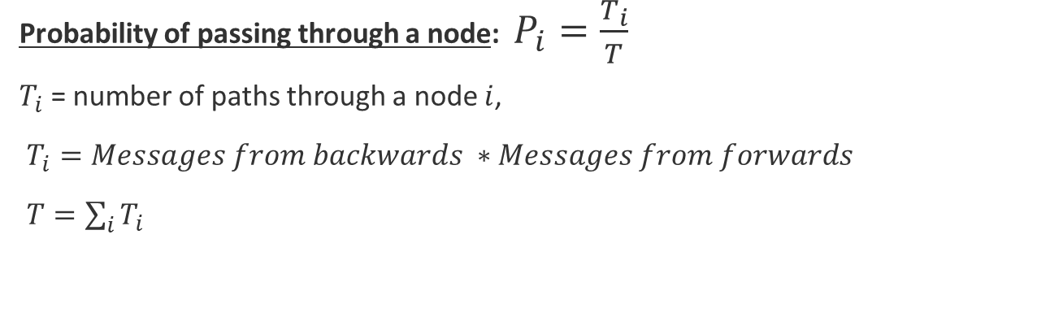

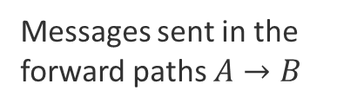
Message Passing for Path counting [McKay 2003]
Messages sent in the
forward paths $A→B$
The five paths $A→B$
Messages sent in the Forward (top-left) and Backward (bottom-right) paths
Probability of passing through a node: $P_{i}=\frac{T_{i}}{T}$
$T_{i}$= number of paths through a node $i$,
$T_{i}=Messages from backwards ∗Messages from forwards$
$T=\sum_{i}{T_{i}}$
[MacKay 2003] MacKay, D. JC.(2003), Information theory, inference and learning algorithms. Cambridge university press.

Slide 21
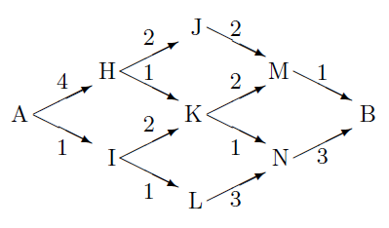
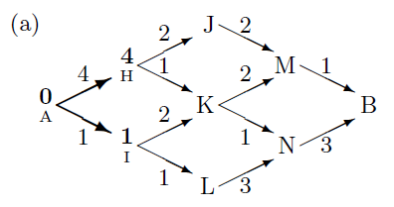
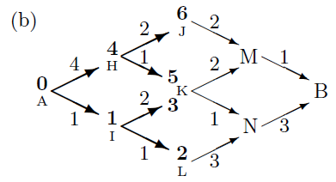
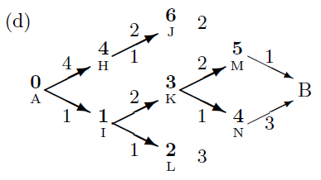
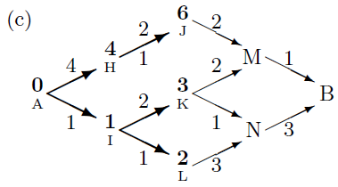
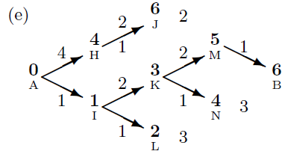
Message Passing – Viterbi algorithm [McKay 2003]
Find the path with lowest cost
Algorithm
Set the cost of first node to zero
As a node learns the costs of its predecessors, it passes these costs to its descendants
As the message passes along each edge in the graph, the cost of that edge is added
When conflicting costs arrive, take the minimum (that is why this algorithm also called min-sum)
[MacKay 2003] MacKay, D. JC.(2003), Information theory, inference and learning algorithms. Cambridge university press.

Slide 22
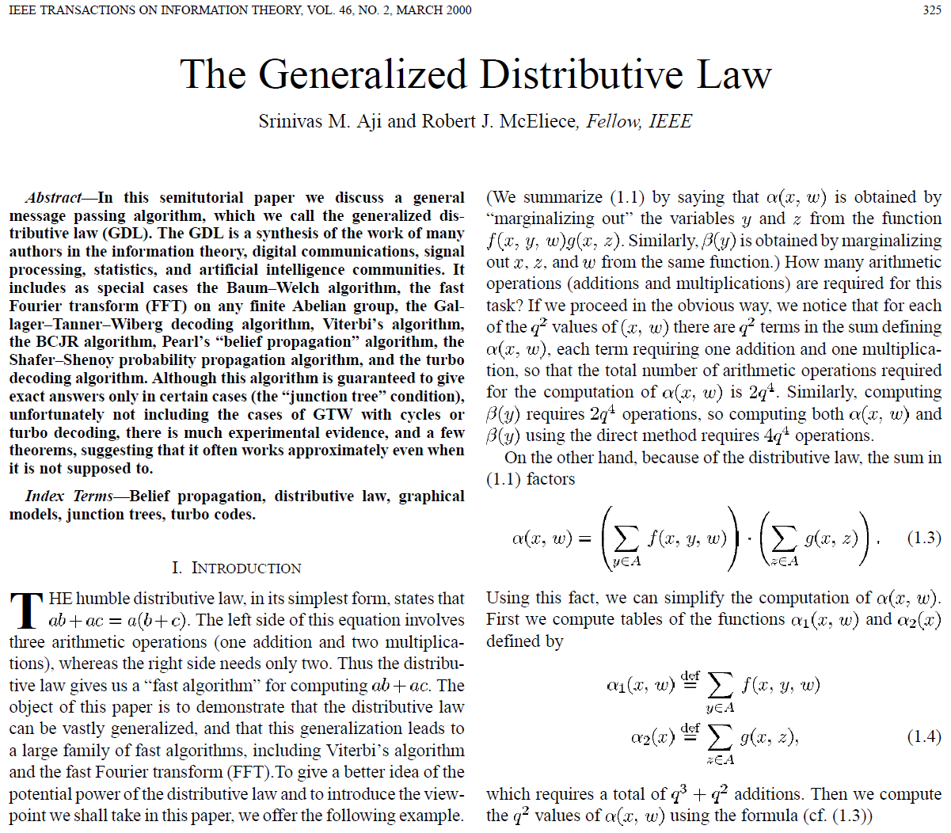
Generalized Distributive Law (GDL)
GDL synthesis of the work in:
information theory
digital communications
Signal processing
statistics
artificial intelligence communities
Algorithms:
Baum-Welch Algorithm (HMM)
Fast Fourier transform (FFT) on any finite Abelian group
Gallager–Tanner–Wiberg decoding algorithm
Viterbi’s algorithm
BCJR algorithm
Pearl’s “belief propagation” algorithm
Aji, Srinivas M., and Robert J. McEliece. "The generalized distributive law." IEEE transactions on Information Theory 46.2 (2000): 325-343.

Slide 23
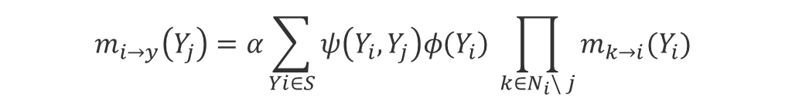
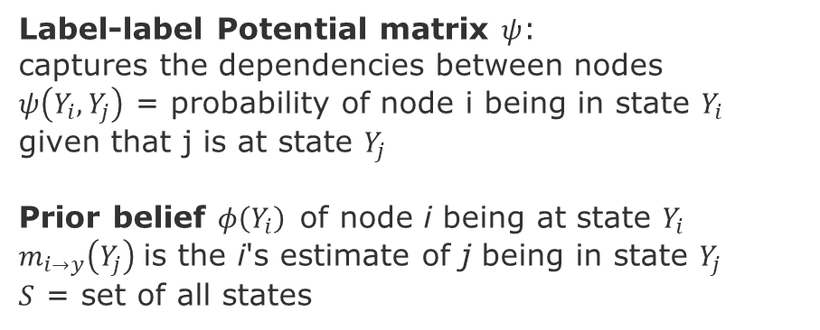
Loopy belief propagation
Label-label Potential matrix $ψ$:
captures the dependencies between nodes
$ψ\left(Y_{i},Y_{j}\right)$ = probability of node i being in state $Y_{i}$ given that j is at state $Y_{j}$
Prior belief $φ\left(Y_{i}\right)$of node i being at state $Y_{i}$
$m_{i→y}\left(Y_{j}\right)$is the i's estimate of j being in state $Y_{j}$
$S$ = set of all states
$$m_{i→y}\left(Y_{j}\right)=α\sum_{Yi∈S}{ψ\left(Y_{i},Y_{j}\right)φ\left(Y_{i}\right) \prod_{k∈N_{i}\backslash j}{m_{k→i}(Y_{i}) }}$$
Sum over all states
Prior
All messages sent by neighbors of node i in the previous iteration
Label-label potential
Advantages
Easy to program and parallelize execution
Applies to any graphical model with different types of potential relationships between nodes
Caveat: no guarantee of convergence

Slide 24
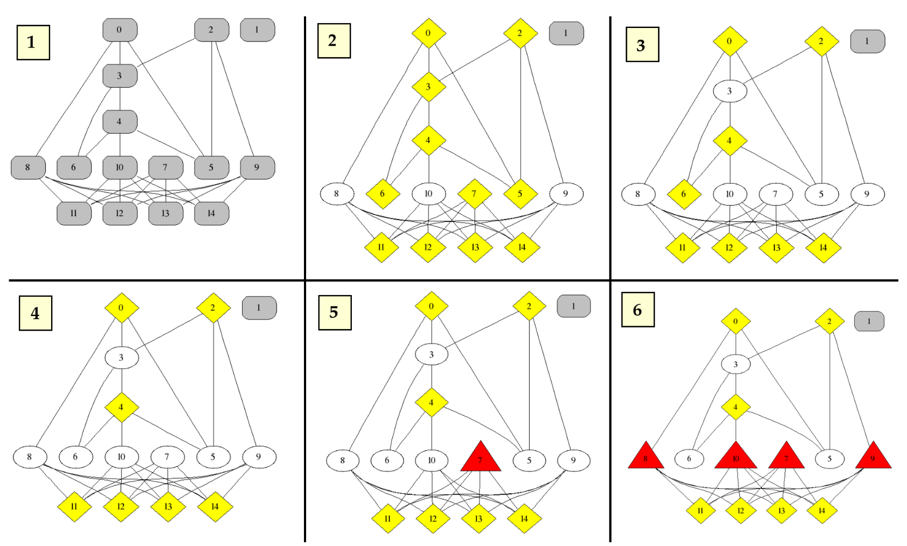
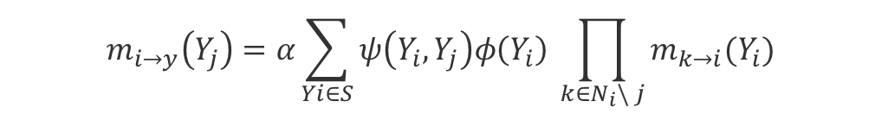
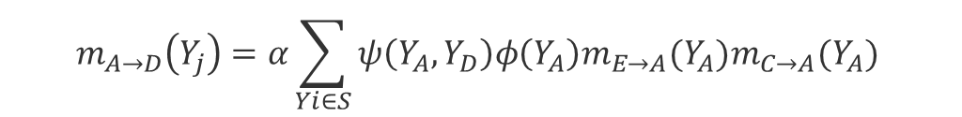
Examples Loopy belief propagation
E
$$m_{i→y}\left(Y_{j}\right)=α\sum_{Yi∈S}{ψ\left(Y_{i},Y_{j}\right)φ\left(Y_{i}\right) \prod_{k∈N_{i}\backslash j}{m_{k→i}(Y_{i}) }}$$
A
F
Example computing the message from A do D :
B
H
$$m_{A→D}\left(Y_{j}\right)=α\sum_{Yi∈S}{ψ\left(Y_{A},Y_{D}\right)φ\left(Y_{A}\right)m_{E→A}(Y_{A})m_{C→A}(Y_{A}) }$$
C
G
D
source:
Pandit, Shashank, et al. "Netprobe: a fast and scalable system for fraud detection in online auction networks." Proceedings of the 16th international conference on World Wide Web. 2007.
red triangles = fraudsters,
yellow diamonds = accomplices,
white ellipses = honest nodes,
gray rounded rectangles = unbiased node

Slide 25
Other applications of loopy belief propagation
Improve in standard graph mining tasks:
Node ranking
Anomaly detection
Clustering
Community detection
Sentiment prediction
Information diffusion

Slide 26
Next Tasks
Initial understanding about your graph data
Generate first instance of your graphs?
Visualize the network or subgraph
Compute basic network-level metrics
Edge degree distribution, Diameter, Clustering coefficient, Component connectivity
Compare with random network or any other relevant reference model
Publish the initial list of papers that you are considering for related work

Slide 27
END

